Slide 1
Civil Rights and Property Rights
Michael Munger
Duke University
PPE Program

Slide 2
Democracy and Rights
French Declaration of the
Rights of Man (August 1789):
3. The source of all sovereignty resides essentially in the nation; no group, no individual may exercise authority not emanating expressly therefrom.
10. No one is to be disquieted because of his opinions, even religious, provided their manifestation does not disturb the public order established by law.
11. Free communication of ideas and opinions is one of the most precious of the rights of man. Consequently every citizen may speak, write, and print freely subject to responsibility for the abuse of such liberty in the cases determined by law.

Slide 3
NOT Democracy and Rights
US Constitution: (September 1789)
We the people of the United States….do ordain and establish this Constitution for the United States
1. Congress shall make no law respecting an establishment of religion, or prohibiting the free exercise thereof; or abridging the freedom of speech, or of the press; or the right of the people peaceably to assemble, and to petition the government for a redress of grievances.

Slide 4


Slide 5
James Madison, "On Property," 1792
[Property] means "that dominion which one man claims and exercises over the external things of the world, in exclusion of every other individual."
In its larger and juster meaning, it embraces every [value and right]; and which leaves to every one else the like advantage.
In the former sense, a man's land, or …or money is called his property. In the latter sense, a man has a property in his opinions and the free communication of them.
He has a property of peculiar value in his religious opinions, and in the profession and practice dictated by them. He has a property very dear to him in the safety and liberty of his person. He has an equal property in the free use of his faculties and free choice of the objects on which to employ them.
In a word, as a man is said to have a right to his property, he may be equally said to have a property in his rights.
Where an excess of power prevails, property of no sort is duly respected. No man is safe in his opinions, his person, his faculties, or his possessions. Where there is an excess of liberty, the effect is the same, tho' from an opposite cause.

Slide 6
Two Interesting Cases: 1
HINMAN v. PACIFIC AIR TRANSPORT, 84 F.2d 755 (1936), 9th Circuit
Ad coelum, fly over, no actual damages (only own that space that you occupy or make use of, must reclaim
Can’t charge for use of airspace: too ripe for holdouts
Trespass/Nuisance Divide Trespass protects interest in possession, nuisance protects use and enjoyment

Slide 7
The
ad coelum rule

Slide 8
Hinman sued the airlines…
Hinman (P) sued to enjoin Paciﬁc Air Transport (D) from ﬂying its airplanes over his house and for damages resulting from the ﬂights that had already occurred.
Airplanes operated by Paciﬁc Air Transport (“Paciﬁc”) regularly ﬂew stop these ﬂights, but Paciﬁc disregarded the requests.
Hinman then sued, arguing that the ad coelum rule gave him the right to prevent aircraft from ﬂying above his land and that such ﬂights were trespasses.
Does the ad coelum rule create an unlimited property right to the airspace above a person’s land, so that ﬂying an airplane over that land constitutes trespass

Slide 9
Two Interesting Cases: 2
Jacque v. Steenberg Homes, Inc., 563 N.W.2d 154 (Wis. 1997).
Steenberg (D) sold a mobile home to Jacque’s (P) neighbor. Steenberg asked Jacque for permission to move the home across P’s land several times and P refused each time. D ignored P’s command and hauled the home across P’s land after first plowing a path through the snow. P called the Sheriff and D was given a citation for $30. P sued D for trespass. The jury awarded P $1 in nominal damages and $100,000 in punitive damages. The Court set aside the award for punitive damages on the grounds that Wisconsin law did not allow a punitive damage award unless the jury also awarded compensatory damages and P appealed.

Slide 10
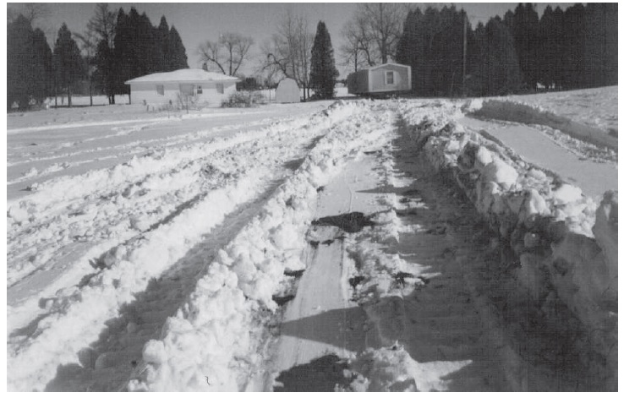
Mobile Home in Final Location

Slide 11
English case: Merest v. Harvey, 128 Eng. Rep. 761 (C.P. 1814)
A landowner was shooting birds in his field when he was approached by the local magistrate who wanted to hunt with him. Although the landowner refused, the magistrate proceeded to hunt. When the landowner continued to object, the magistrate threatened to have him jailed and dared him to file suit. Although little actual harm had been caused, the English court upheld damages of 500 pounds, explaining “in a case where a man disregards every principle which actuates the conduct of gentlemen, what is to restrain him except large damages?” McWilliams, 3 Wis. 377 at 380.

Slide 12
English case: Merest v. Harvey, 128 Eng. Rep. 761 (C.P. 1814)
Judge's hypothetical from Merest:
Suppose a gentleman has a paved walk in his paddock, before his window, and that a man intrudes and walks up and down before the window of his house, and looks in while the owner is at dinner, is the trespasser permitted to say “here is a halfpenny for you which is the full extent of the mischief I have done.” Would that be a compensation? I cannot say that it would be...

Slide 13
Two Views of Property
1. A bundle of sticks, decided by majorities (Hinman).
Rights in personam : rights against a small and defined class. That is, you have the rights specified, only.
2. The right to exclude, majorities or others be damned (Jacques).
Rights in rem : rights against a large and indefinite class. That is, you have rights unless they are proscribed.

Slide 14
Liberty (Wesley Hohfeld)
I am at liberty to use P =

Slide 15
Liberty (Wesley Hohfeld)
I am at liberty to use P = no duty to refrain

Slide 16
Liberty (Wesley Hohfeld)
I am at liberty to use P = no duty to refrain
Right

Slide 17
Liberty (Wesley Hohfeld)
I am at liberty to use P = no duty to refrain
Right
I have a right to P

Slide 18
Liberty (Wesley Hohfeld)
I am at liberty to use P = no duty to refrain
Right
I have a right to P = I am at liberty to use P

Slide 19
Liberty (Wesley Hohfeld)
I am at liberty to use P = no duty to refrain
Right
I have a right to P = I am at liberty to use P + others are not at liberty

Slide 20
Liberty (Wesley Hohfeld)
I am at liberty to use P = no duty to refrain
Right
I have a right to P = I am at liberty to use P + others are not at liberty
A property right in the full sense implies a right to say no.

Slide 21
Three ways of protecting property P:

Slide 22
Three ways of protecting property P:
1. Property rule:

Slide 23
Three ways of protecting property P:
1. Property rule: no transfer without permission

Slide 24
Three ways of protecting property P:
1. Property rule: no transfer without permission
2. Liability rule:

Slide 25
Three ways of protecting property P:
1. Property rule: no transfer without permission
2. Liability rule: no transfer without compensation

Slide 26
Three ways of protecting property P:
1. Property rule: no transfer without permission
2. Liability rule: no transfer without compensation
3. Inalienability rule:

Slide 27
Three ways of protecting property P:
1. Property rule: no transfer without permission
2. Liability rule: no transfer without compensation
3. Inalienability rule: no transfer at all

Slide 28
Tests of a functional system of property:

Slide 29
Tests of a functional system of property:
1. How does it affect productivity?

Slide 30
Tests of a functional system of property:
1. How does it affect productivity?
2. Do people realize gains from trade?

Slide 31
Tests of a functional system of property:
1. How does it affect productivity?
2. Do people realize gains from trade?
3. Are externalities internalized?

Slide 32
Tests of a functional system of property:
1. How does it affect productivity?
2. Do people realize gains from trade?
3. Are externalities internalized?
4. Does it encourage creative destruction?

Slide 33
Tests of a functional system of property:
1. How does it affect productivity?
2. Do people realize gains from trade?
3. Are externalities internalized?
4. Does it encourage creative destruction?
5. Is the system just?

Slide 34
There were truths judge was trying to track in Hinman v. Pacific Air case:
1. about what institutional framework enables people to live well together,
2. about what enables people to mind their own business, &
3. About how to avoid creating property rights that empower people to hold each other for ransom.

Slide 35
A working property system:
1. Puts people in a position to PRODUCE.
2. Puts producers in a position to TRADE.
3. Fosters CREATIVE DESTRUCTION
4. Limits EXTERNALITIES.
5. Limits TRANSACTION COST.
6. Enables producers to grow their business .

